Slide 1
BITS Pilani

Slide 2
Comprehensive Project Presentation

Slide 3
Pre-Processing
Converted data from .txt file to .xlsx file.
In the label column we had “ALARM” or “0”. Converted it to “1” or “0”.
Removed rows entirely containing 0’s.
For rows have 1-2 missing values we used the median to fill the missing value.

Slide 4
Model Evaluation
With the previous preprocessing we implemented 3 models namely Isolation Forest, Local Outlier Factor, and Support Vector Machine. The results were are below:
Model | Accuracy (AUC)
Isolation Forest | 61.01%
Local Outlier Factor | 59.10%
Support Vector Machine | 64.90%

Slide 5
New Pre-Processing
We extended the previous pre-processing and made alarm columns for each individual features using the normal range of values for each feature as the limits.
After creating individual alarm column we merged these into single alarm column.
We also took care of the corelation between features.

Slide 6
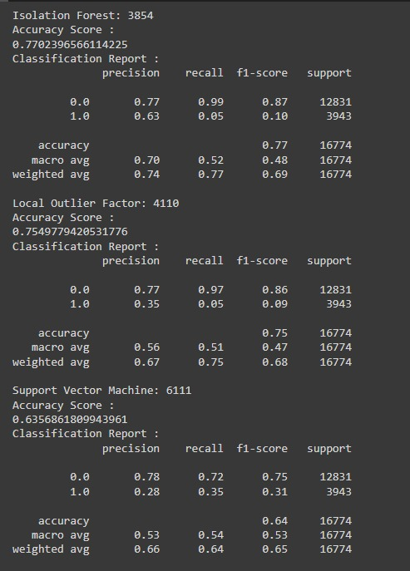
Model Evaluation
We used the new pre-processed data for model training and evaluation and got improved results than before.
The results are as below :

Slide 7
Use of Box-plot in Models
We used box-plot to ensure that enough negative examples are covered while training the models.
The results were almost the same and are as below :

Slide 8
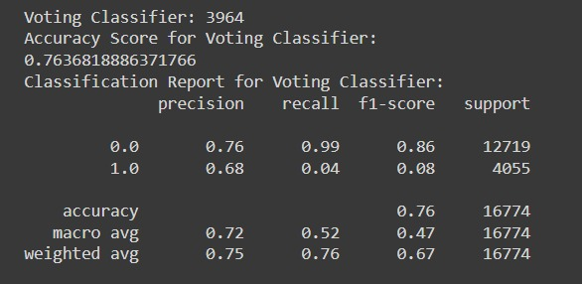
Creating Voting Classifier
We created an ensemble model using voting classifier (on iForest, LOF, SVM) and used gridsearchCV method to tune the model’s hyperparameters.
But still the result was the same and as below :

Slide 9
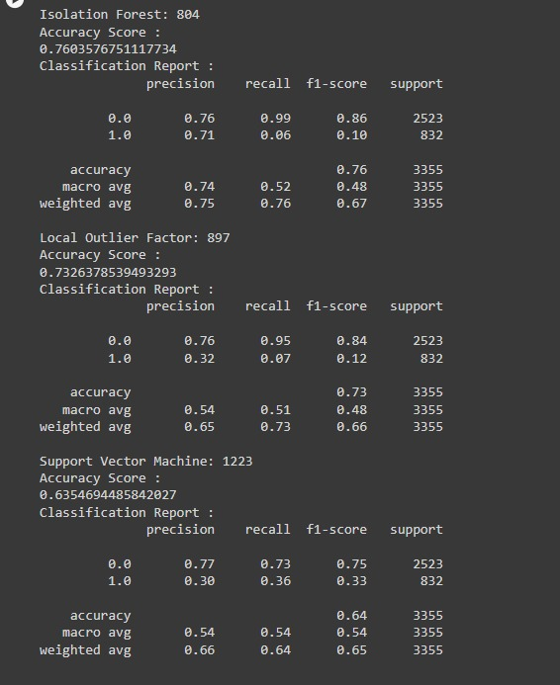
Use of Autoencoder in Models
We used autoencoder for feature training.
The results were almost the same and are as below :

